Slide 1
BIG DATA
Seminar
Weights & Biases
Group KHMT2-02

Slide 2
GROUP MEMBER
Name | ID
Phạm Đặng Sơn Hà | 21127206
Nguyễn Minh Quân | 21127403
Nguyễn Tấn Lộc | 21127099
Trần Đại Niên | 21127664

Slide 3

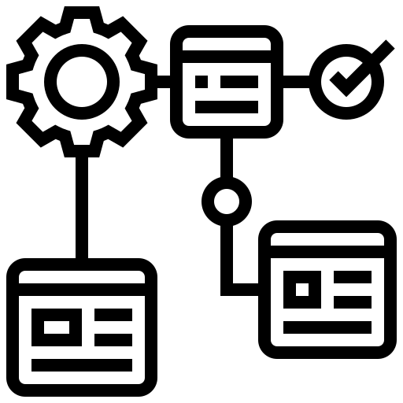


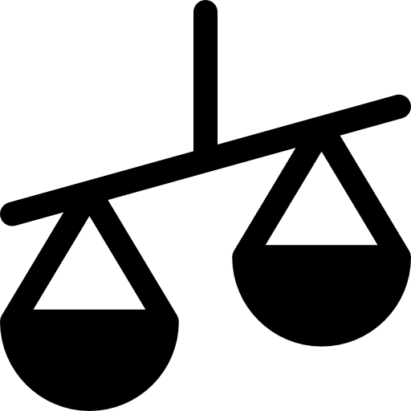
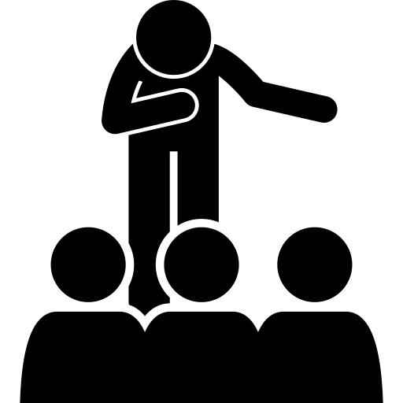
TABLE OF CONTENTS
01
02
03
INTRODUCTION
MAJOR COMPONENTS
APPLICATION
04
05
06
DEMO
COMPARISON
CONCLUSION

Slide 4
INTRODUCTION
01

Slide 5
Motivation
Traditional methods for managing and comparing between experiments are not good:
When changing hyperparameters, techniques -> creating more outputs -> hard to tracks
Disadvantages of tracking by Excel sheet:
Limitations in Recording
Time Intensive Logging
Dispersed Outputs
Lack of Visual Comparison

Slide 6
Problem:
Classifying images of cats and dogs
Data set: Cats vs Dogs
The goals: To develop a model that can distinguish between images of cats and dogs
Difficulties:
Choose appropriate architecture for the neural network: LeNet-5, ResNet, VGG16 or VGG19, …
Have to tune hyperparameters: learning rate, batch size, and dropout rates

Slide 7
Major
Components
02

Slide 8
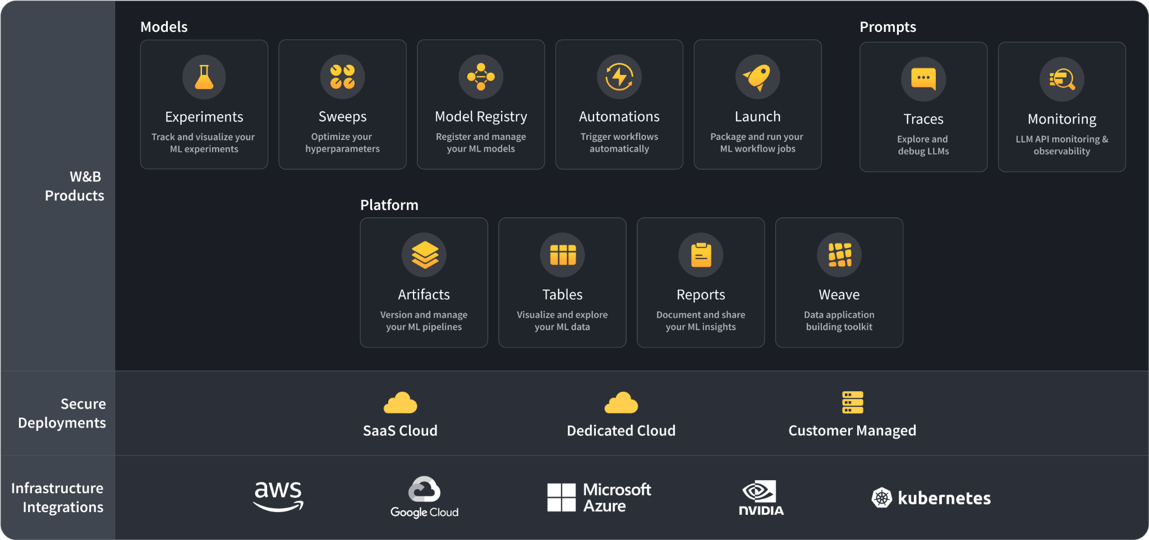
2. Major components
This diagram outlines the relationship between W&B products.

Slide 9
W&B
Models
02
Major Components

Slide 10
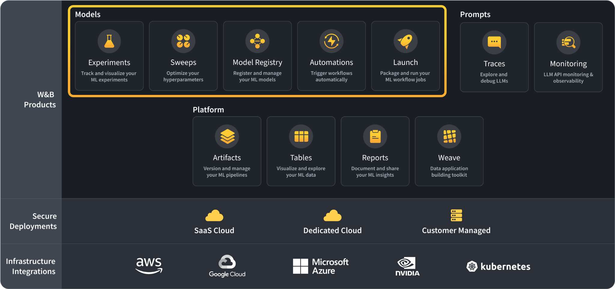
2.1. W&B Models
W&B Models is the system of record for ML Practitioners who want to organize their models, boost productivity and collaboration, and deliver production ML at scale.

Slide 11
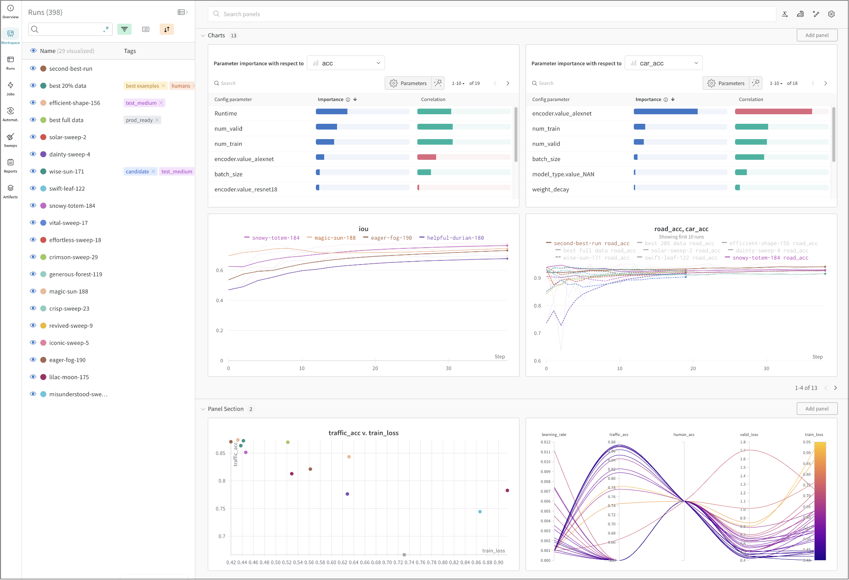
2.1.1. Experiments
Track machine learning experiments, review the results in an interactive dashboard or export data to Python with W&B Experiments.

Slide 12
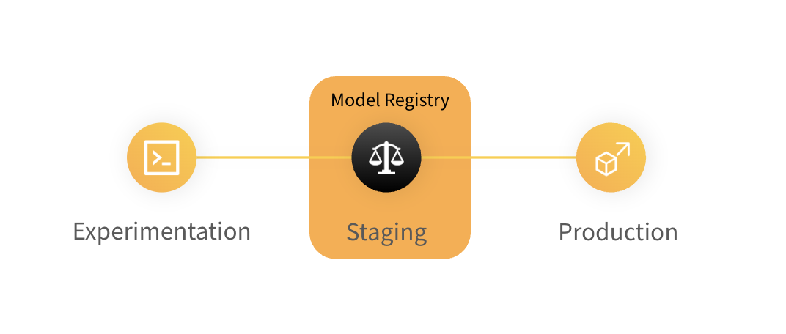
2.1.2. Model Registry
The W&B Model Registry houses a team's trained models where ML Practitioners can publish candidates for production to be consumed by downstream teams and stakeholders.

Slide 13
2.1.3. Launch
Easily scale training runs from your desktop to a compute resource like Amazon SageMaker, Kubernetes and more with W&B Launch.

Slide 14
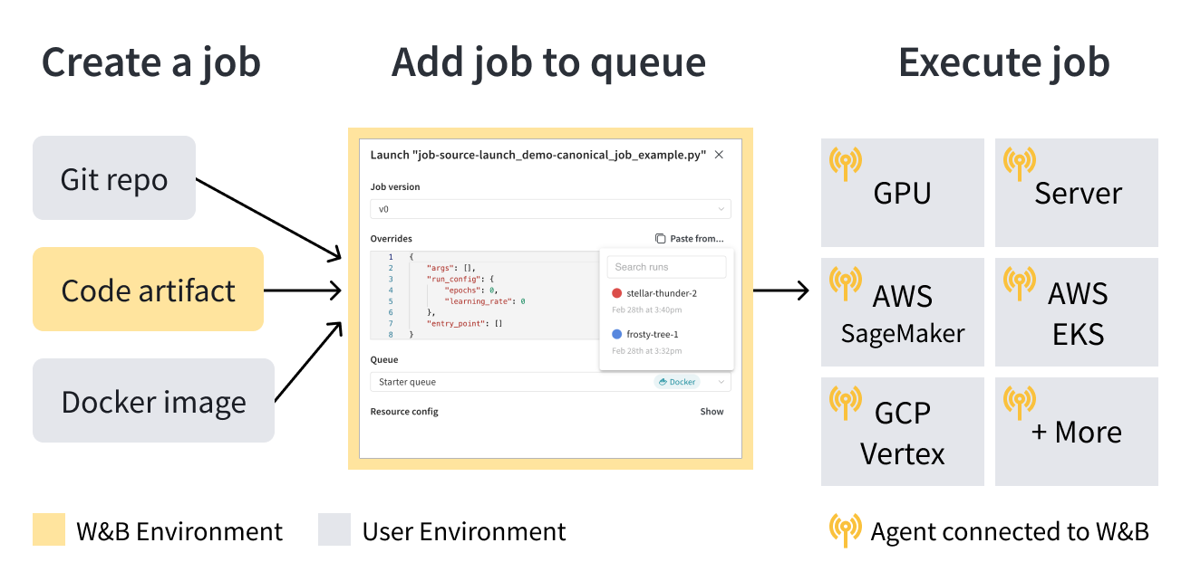
2.1.3. Launch
Launch is composed of three fundamental components: launch jobs, queues, and agents.

Slide 15
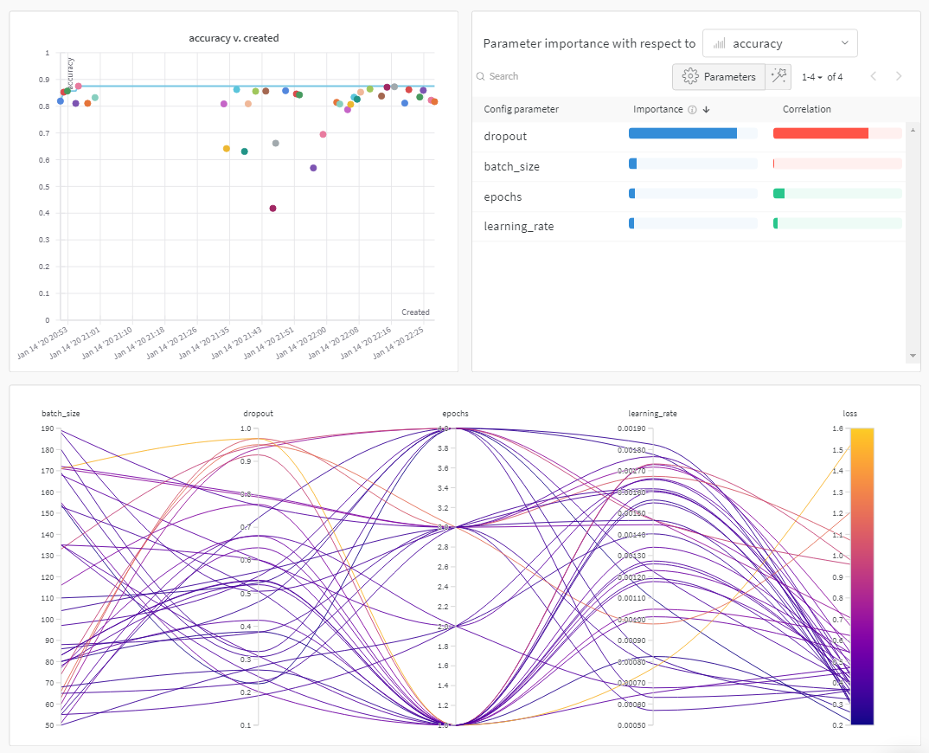
2.1.4. Sweeps
Use W&B Sweeps to automate hyperparameter search and visualize rich, interactive experiment tracking. Scale and parallelize sweep across one or more machines.

Slide 16
W&B
Platform
02
Major Components

Slide 17
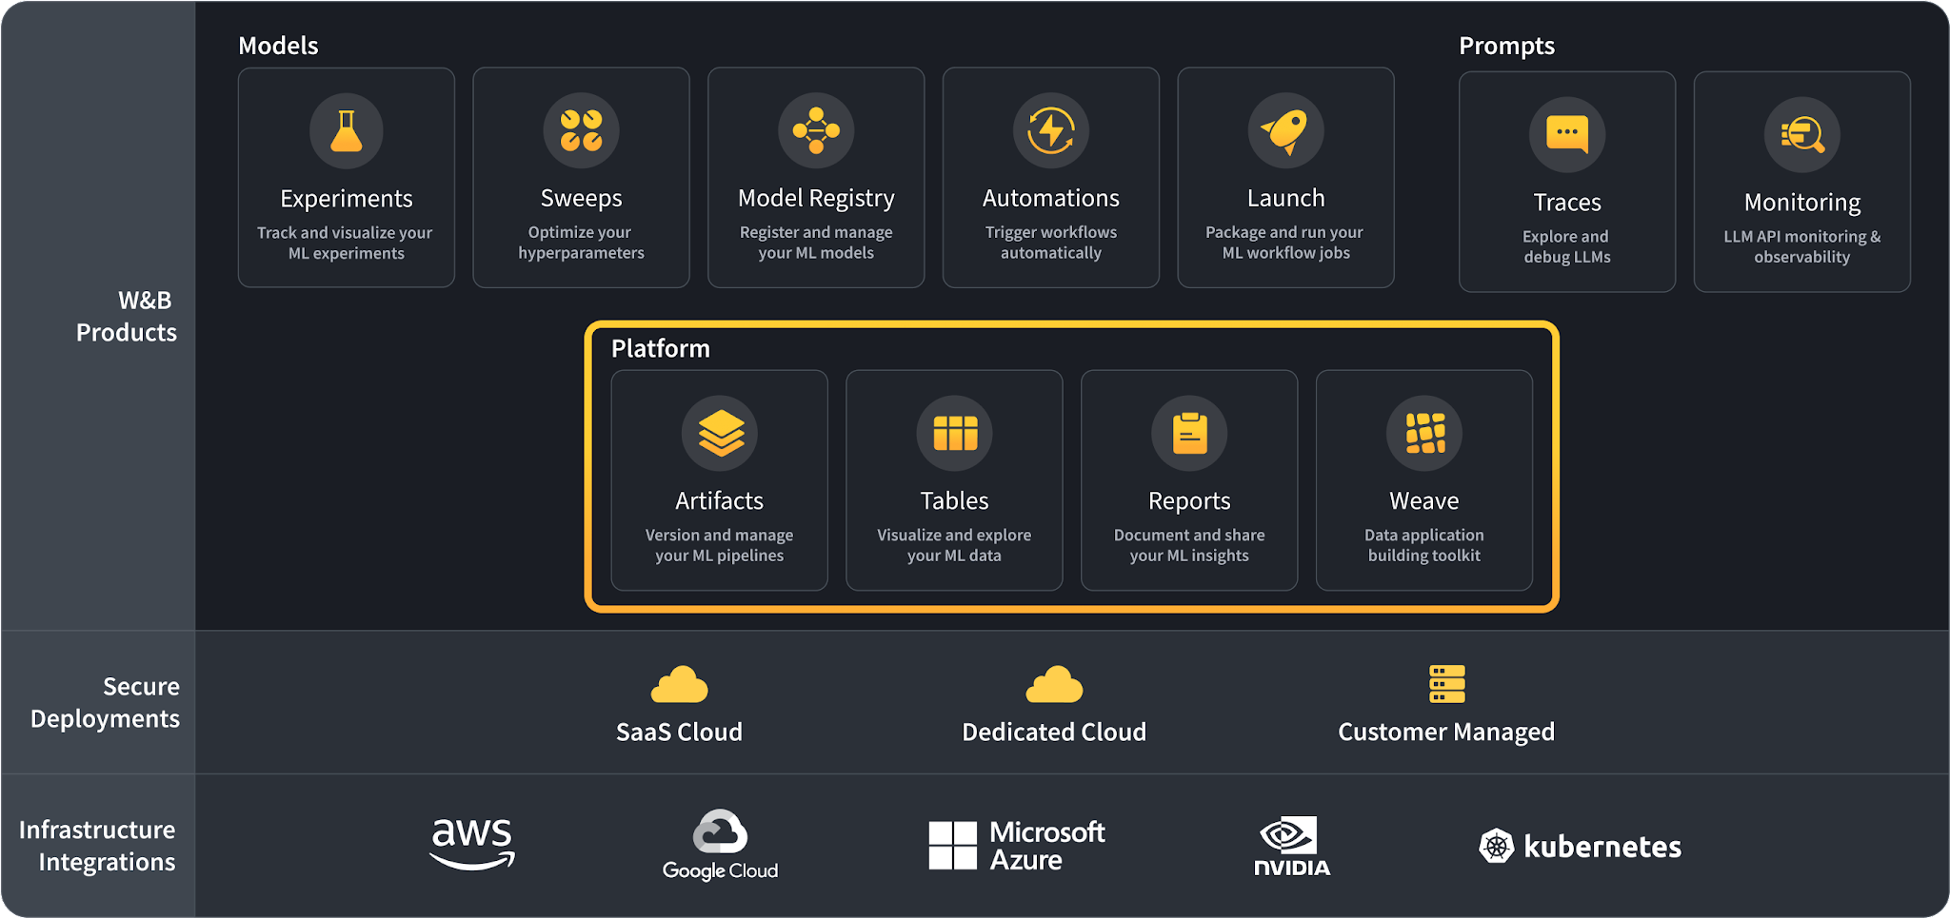
2.2. W&B Platform
W&B Platform is the foundational framework supporting W&B Models and W&B Prompts, with secure enterprise deployment options and flexible multi-cloud support with all industry leaders.

Slide 18
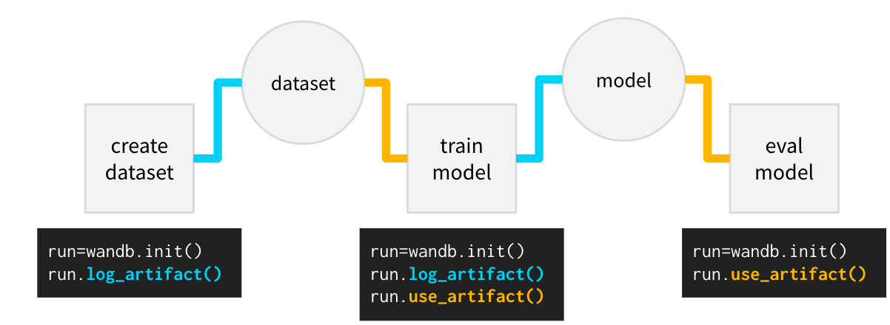
2.2.1. Artifacts
Use W&B Artifacts to track and version any serialized data as the inputs and outputs of your W&B Runs.

Slide 19
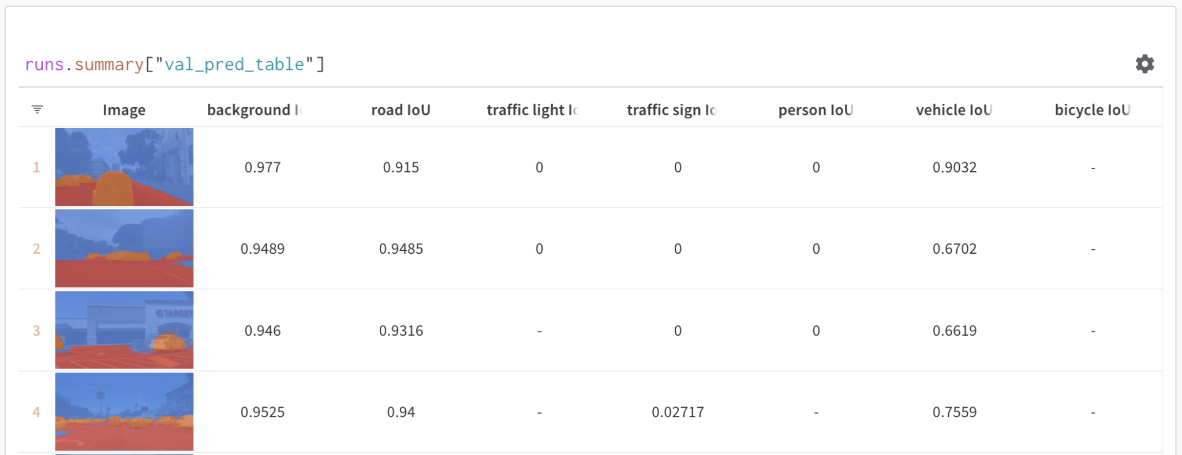
2.2.2. Tables
Use W&B Tables to visualize and query tabular data.

Slide 20
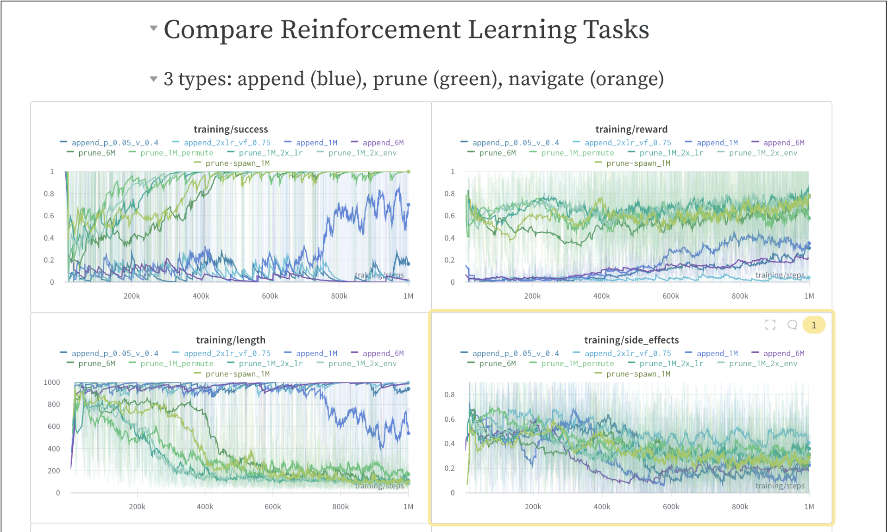
2.2.3. Reports
Use W&B Reports to organize Runs, embed and automate visualizations, describe your findings, and share updates with collaborators. Easily export your report as a LaTeX zip file or convert the file to PDF.

Slide 21
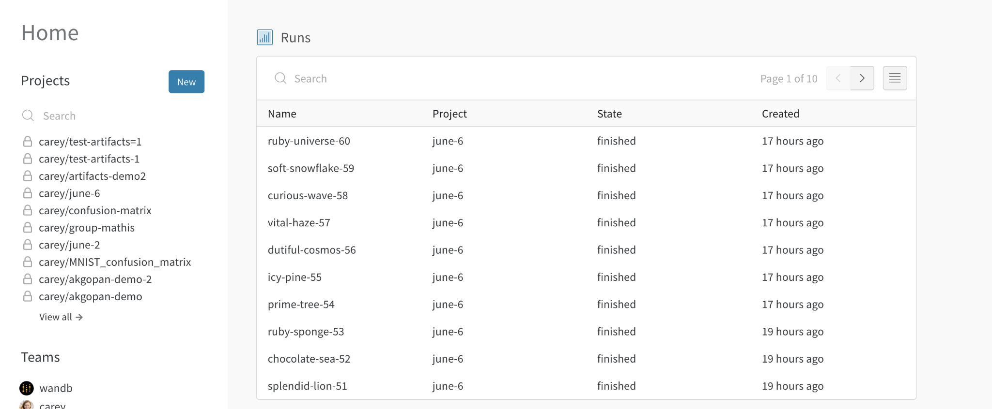
2.2.3. App UI
W&B provides a web-based platform for experiment tracking, visualization, and collaboration for machine learning projects.

Slide 22
Application
03

Slide 23
3. Application
Weights & Biases (W&B) is a versatile platform that finds applications in both academic and industry activities:
Experiment tracking and reproducibility
Development and optimization of machine learning models
Monitoring and debugging production models
Visualization and analysis
Performance comparison and benchmarking
Team communication, collaboration and sharing
Publishing and documentation

Slide 24
Demo
04

Slide 25
Comparison
05

Slide 26
5. Comparison
Feature | W&B | Neptune.ai | Amazon SageMaker | Azure Machine Learning
Pricing | Free & Paid | Free & Paid | Included in AWS Service | Included in Azure Service
Key Features | Experiment tracking, visualizations, collaboration, deployment monitoring | Experiment tracking, data versioning, model governance, collaboration | Experiment tracking, model building, training, deployment (full ML platform) | Experiment tracking, model building, training, deployment (full ML platform)
Ease of Use | Easy | Moderate | Can be complex | Can be complex

Slide 27
5. Comparison
Feature | W&B | Neptune.ai | Amazon SageMaker | Azure Machine Learning
Collaboration | Good features for team collaboration | Excellent collaboration features | Limited collaboration within SageMaker | Limited collaboration within Azure ML
Scalability | Scales well | Scales well | Scales with AWS resources | Scales with Azure resources
Cloud-based | Standalone | Standalone | Yes (AWS Cloud) | Yes (Azure Cloud)

Slide 28
Conclusion
06

Slide 29
Conclusion:
Weights & Biases simplifies experiment tracking by automatically logging metrics, hyperparameter, and artifacts, eliminating the need for manual record-keeping.
The centralized dashboard provides a clear and organized overview of experiment details.
The collaborative nature of Weights & Biases facilitates teamwork by allowing easy sharing and comparison of experiment results.

Slide 30
Thanks for your attention

